Slide 1
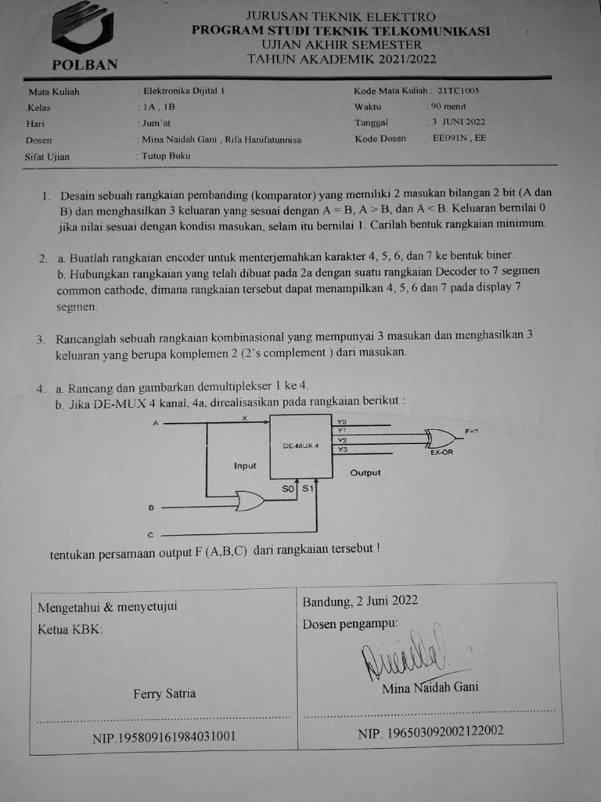

Slide 2

















A | B | C2 (A=B) | C1 (A>B) | C0 (A<B)
0 | 0 | 0 | 1 | 1
0 | 1 | 1 | 1 | 0
1 | 0 | 1 | 0 | 1
1 | 1 | 0 | 1 | 1

Slide 3








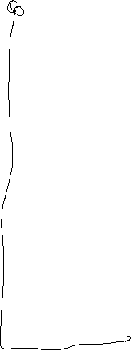












Slide 4













Slide 5











Slide 6

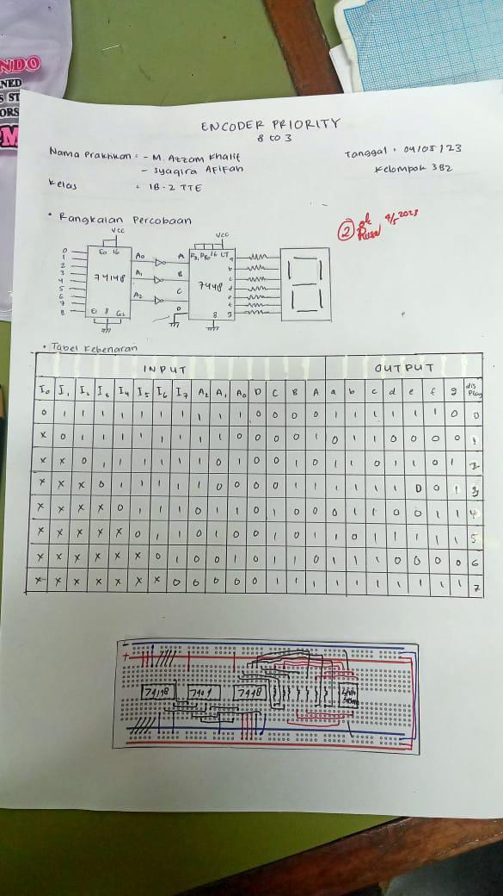



















Slide 7


Slide 8













A | B | C | Y0 | Y1 | Y2
0 | 0 | 0 | 0 | 0 | 0
0 | 0 | 1 | 1 | 1 | 1
0 | 1 | 0 | 1 | 1 | 0
0 | 1 | 1 | 1 | 0 | 1
1 | 0 | 0 | 1 | 0 | 0
1 | 0 | 1 | 0 | 1 | 1
1 | 1 | 0 | 0 | 1 | 0
1 | 1 | 1 | 0 | 0 | 1
A/BC | 00 | 01 | 11 | 10
0 |  | 1 | 1 | 1
1 | 1
A/BC | 00 | 01 | 11 | 10
0 |  | 1 |  | 1
1 |  | 1 |  | 1
A/BC | 00 | 01 | 11 | 10
0 |  | 1 | 1
1 |  | 1 | 1

Slide 9











Slide 10







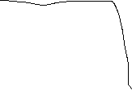













Slide 11









